Slide 1
Multi-dimensional Modeling of Interactions between Nutrients and Riparian Vegetation for Improved Riverine Ecosystem Management
PDT Lead: Todd Steissberg
Product Development Team: Billy Johnson, Zhonglong Zhang, Alex Sanchez, Mark Jensen, Chuck Theiling
Corps District Collaboration: Brian Zettle (CoP Lead), Chris Solek (Los Angeles District), Craig Evans (St. Paul District), Jeff Tripe (Kansas District)

Slide 2
Project Purpose - Recap
SON: 2015-ER-1 - Multi-dimensional Modeling of Interactions between Nutrients and Riparian Vegetation for Improved Riverine Ecosystem Management
Need:
The Corps needs a science-based, defensible tool to quantify ecosystem benefits to the aquatic environment and to riparian buffers that result from ecosystem restoration projects.
Purpose:
Improve Vegetation Mapping - Riparian vegetation can be better represented by 2D meshes than by simple 1D cross-sections.
Improve Vegetation Modeling - Integrating water quality and riparian vegetation modeling into the multi-dimensional hydrodynamic model (HEC-RAS-2D) will be better able to model nutrients and riparian vegetation, and their interactions in both aquatic systems and floodplains.
Notes:
Keep it simple and clear. You may use a second slide if needed, however.

Slide 3
Benefits
Improves decision-making capabilities and reduces operations and maintenance costs
HEC-RAS models provide detailed river hydraulics data and maps (flow, velocity, and water levels). Integrating water quality capabilities leverages these capabilities and existing models to provide detailed hydraulics, water quality and riparian vegetation information for rivers.
HEC-RAS is already widely deployed for ecosystem restoration projects – as a hydraulic model. Additional vegetation and water quality capabilities provide critical short-term and long-term information about dynamic river systems. This helps in designing restoration projects that are stable and functional, while also reducing operations and maintenance costs.
Leverages existing models and expertise, reducing costs
HEC-RAS is widely deployed (100,000 downloads per year), with calibrated hydraulic models already applied to almost all rivers and streams in the U.S., thus reducing the cost of building WQ/vegetation models by at least 50%.
Notes:
Keep it simple and clear. You may use a second slide if needed, however.

Slide 4
Approach
HEC-RAS 1D water quality and vegetation (RVSM) development tasks have been completed, including a Jupyter notebook UI for RVSM.
These provide essential capabilities needed for current and future USACE studies.
Develop 2D WQ as a separate program that will:
Leverage existing and future HEC-RAS hydraulics models
Allow independent development, distribution, and maintenance by EL staff
The new approach will:
Adapt and extend the 2D WQ transport module (“solver”) developed in FY19
Improve and utilize EL’s CLEARWATER modules (TSM, NSM, etc.)
Components:
2D WQ transport module
CLEARWATER modules
Python computational framework
Jupyter notebook interface

Slide 5
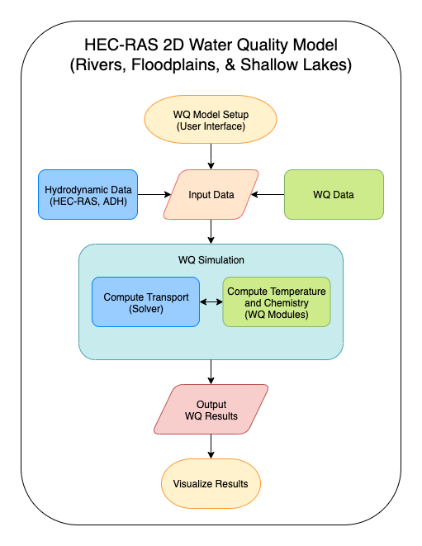
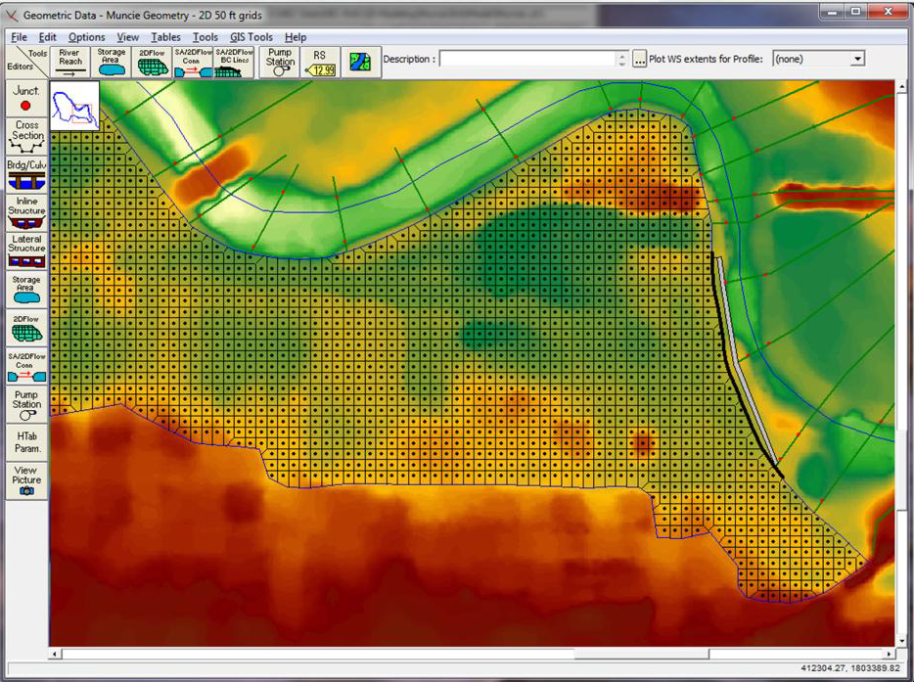
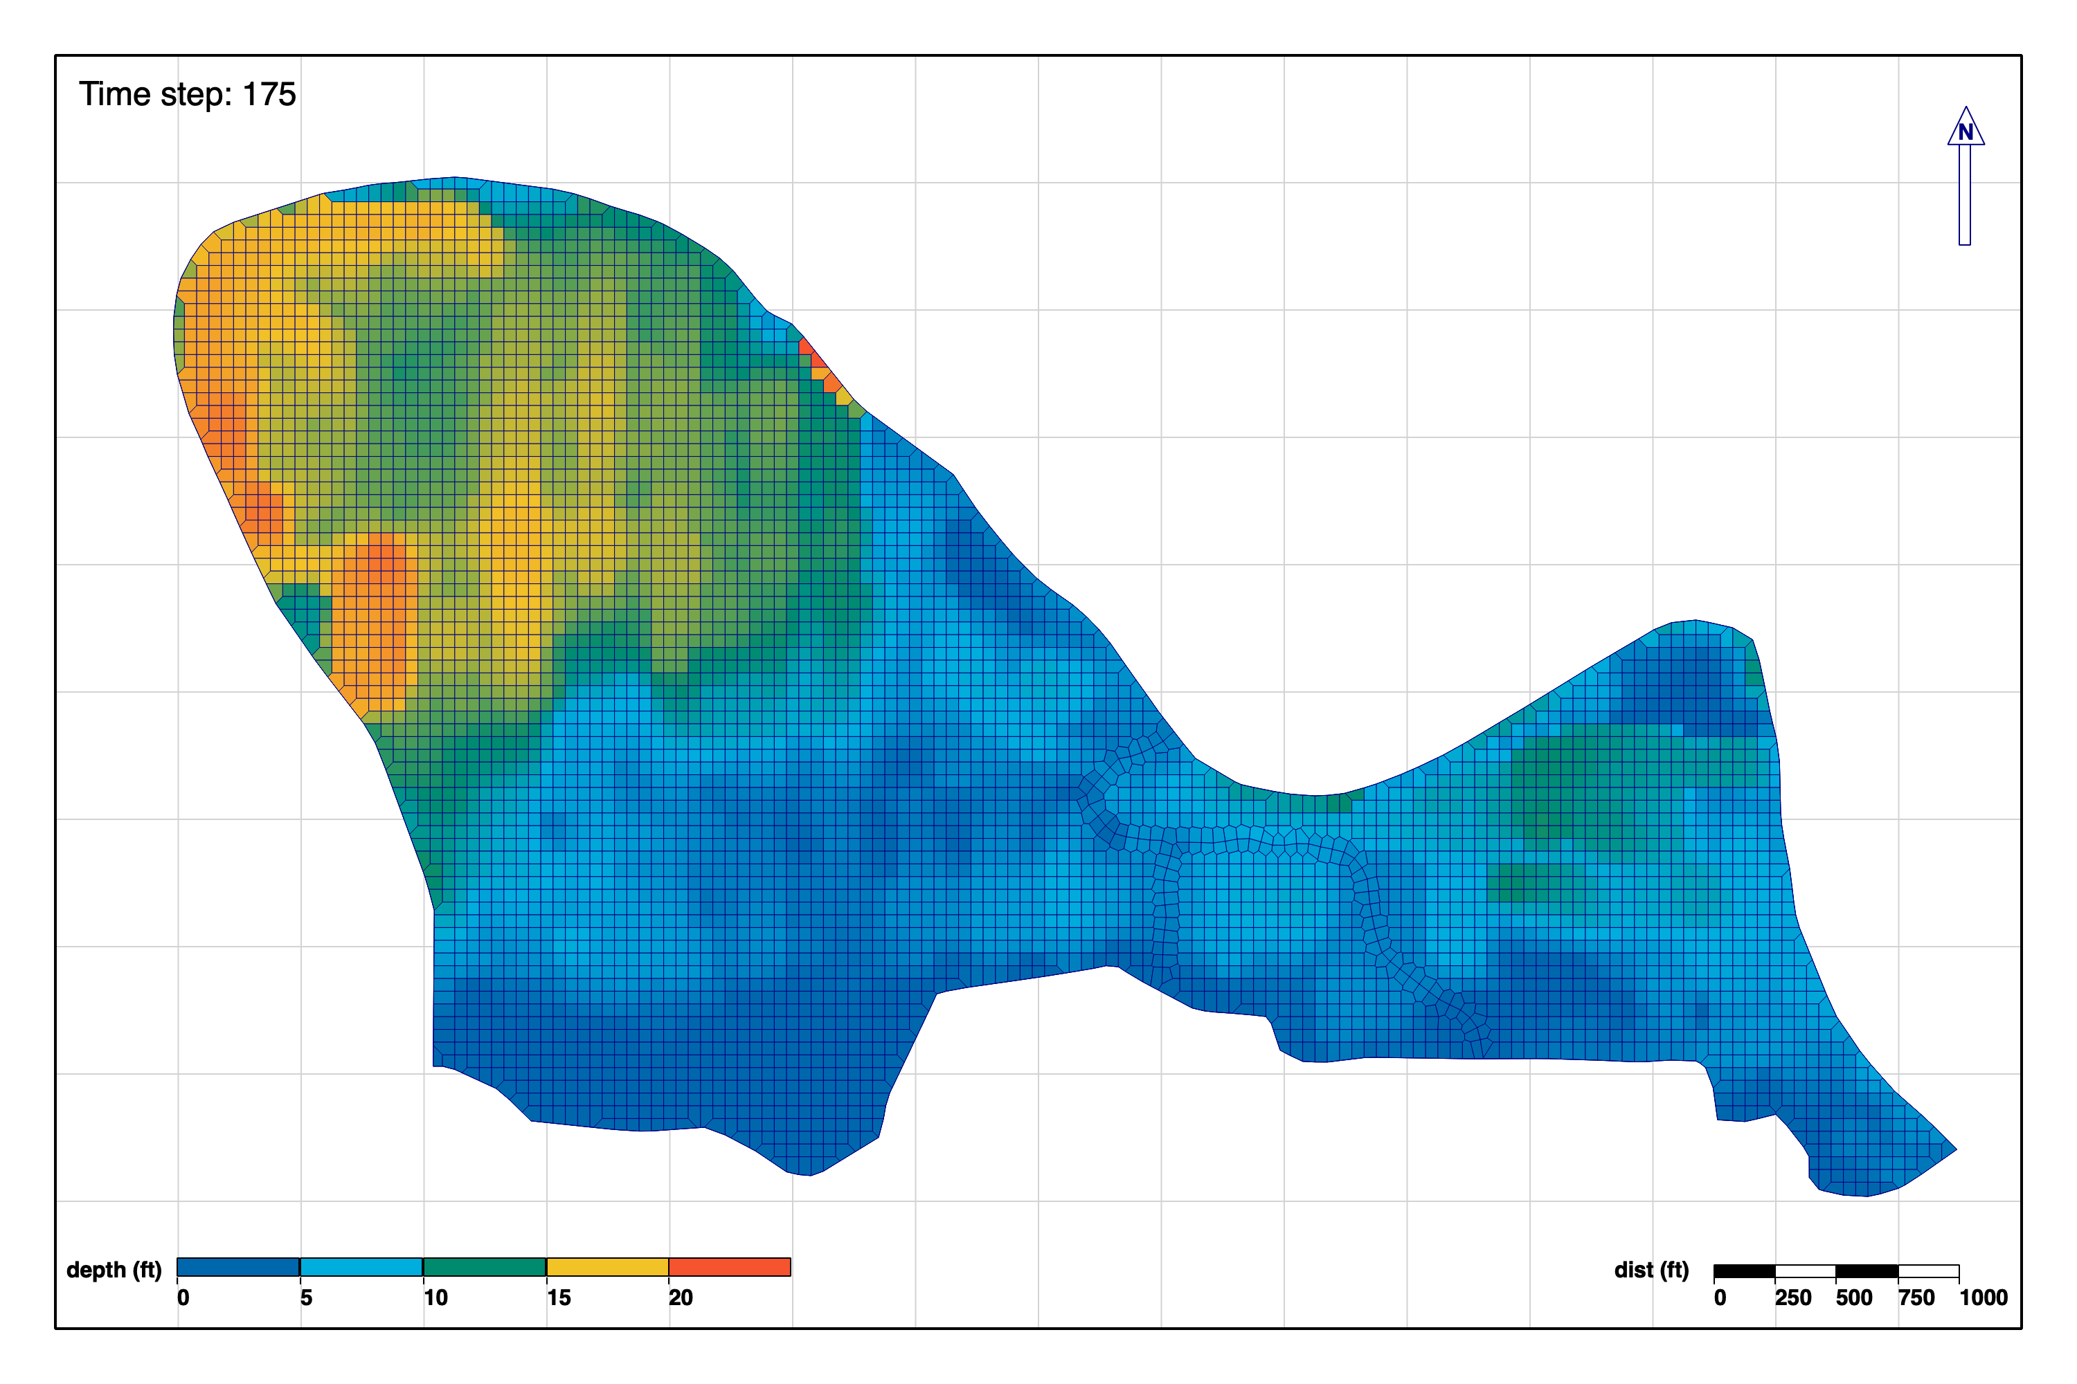
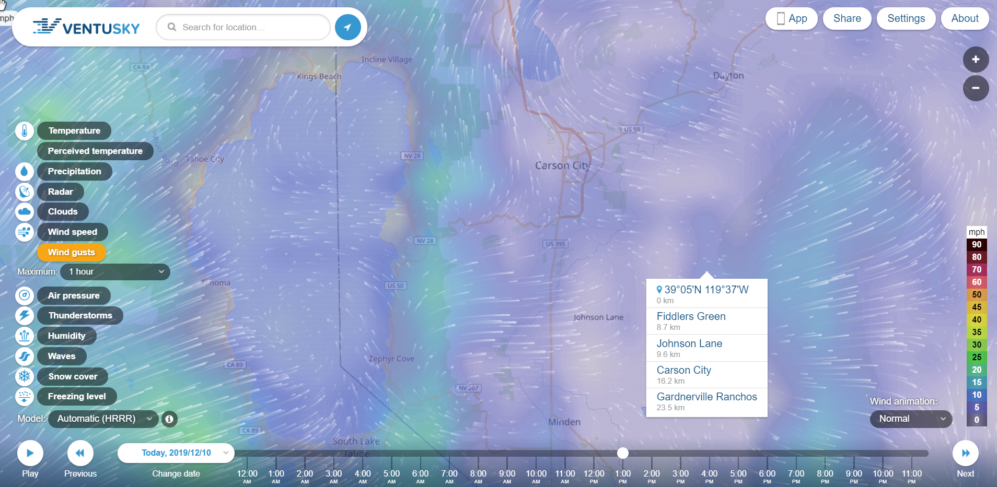
Approach 2D Water Quality
Notes:
Include all PRODUCTS/DELIVERABLES as specified in the original WU documentation

Slide 6
Scheduled Products RAS 2D WQ Tasks, FY20-22
Scheduled Products
Task | Description | Scheduled Due Date (Qtr/Year)
1. | Upgrade WQ modules & documentation (temperature, general constituents, nutrients) | Q2/FY21
2. | Build vegetation and WQ user interface (UI) tools | Q1/FY21
3. | Finalize 2D transport solver (advection-diffusion) | Q3/FY21
4. | Link 2D transport solver, WQ modules, and UI | Q4/FY21
5. | Testing and validation | Q2/FY22
6. | Technical Transfer: Documentation (TR and TN) and project demo | Q4/FY22
7. | Technical Transfer: Workshop | Q4/FY22
Notes:
Include all PRODUCTS/DELIVERABLES as specified in the original WU documentation

Slide 7
FY 20 Accomplishment 1
The National Conference on Ecosystem Restoration (NCER), Virtual, July 2021
Organized two sessions on water quality modeling software and applications
The development team and collaborators presented six abstracts on NSM, RAS 1D WQ, RAS RVSM, and applications
Notes:
Describe product and capability, importance/impact, etc.. Describe product and capability. Employ images generously. Tell a good story.

Slide 8
FY 20 Accomplishment 2
NNNN
Notes:
Describe product and capability, importance/impact, etc.. Describe product and capability. Employ images generously. Tell a good story.

Slide 9
Synopsis
Funding
FY20 $250K
FY21 $360K
FY22 $365K
Project $975K
Project Status
Completed alpha version of “ClearWater-Riverine” modeling tool that simulates water quality using models generated by HEC-RAS-2D
Project Focus
Under revised scope, RAS 2D WQ was developed as a separate product, “ClearWater-Riverine”
Jupyter notebook interface
Leverages HEC-RAS models and capabilities independent of the HEC-RAS development cycle
Reads geometry and hydraulic outputs from HEC-RAS-2D
Alpha version complete: framework, transport engine, plotting functions, user interface
Notes:
Funding for all FY’s funded

Slide 10
Summary
2D water quality transport subroutine was developed in HEC-RAS
Research and literature review for upgrading NSMs and RVSM are completed.
Development of updated NSMs and RVSM has been completed.
Application of HEC-RAS and RVSM modeling system to the Upper MS River and Santa Ana River has been completed.
HEC and EL management are collaborating closely with one another and with the development team.
Bi-weekly progress report meetings are being held to keep project on schedule.
Prototypes have been built for the initial conditions editor, geometry framework, geometry visualization, etc.
WQ module design is currently underway: reorganizing, improving, extending, and porting to Python.

